Slide 1
Class 10: Precontractual liability and Definiteness

Slide 2
Topics
The requirement of definiteness
Possible legal effects of preliminary statements
  Unenforceable preliminary agreement
  Enforceable agreement subject to formalization (Tribune I)
  Enforceable agreement to negotiate in good faith (Tribune II)
  Promissory estoppel
  Promissory fraud
  Misrepresentation
  Restitution

Slide 3
Key questions
Is there an enforceable promise?
  Mutual assent
  Consideration
  Definiteness
Has it been breached?
Has performance been excused?
How should it be enforced?

Slide 4
Definiteness

Slide 5
The requirement of definiteness
Alternative formulations of the requirement:
Terms must “provide a basis for determining the existence of a breach and for giving an appropriate remedy.”
“Parties must have reached agreement on all essential terms.”
Also note that:
“Damages are not recoverable for loss beyond an amount that the evidence permits to be established with reasonable certainty.”
Specific relief will not be granted unless the terms of the contract are sufficiently certain.

Slide 6
Sun Printing & Publishing v. Remington Paper & Power (353)
“For the balance of the period of this agreement the price of the paper and length of terms for which such price shall apply shall be agreed upon by and between the parties hereto fifteen days prior to the expiration of each period for which the price and length of term thereof have been previously agreed upon, said price in no event to be higher than the contract price for news print charged by the Canadian Export Paper Company to the large consumers, the seller to receive the benefit of any differentials in freight rates.”

Slide 7
Sun Printing & Publishing v. Remington Paper & Power (353)
Did the parties intend the agreement to be legally binding?
In what sense was the agreement indefinite?
Why didn’t the court fill the gap with reasonable terms?
    How would damages be calculated?
    What if the price had fallen?

Slide 8
Oglebay Norton v. Armco (366)
“Armco agrees to pay * * * for all iron ore transported hereunder the regular net contract rates for the season in which the ore is transported, as recognized by the leading iron ore shippers in such season for the transportation of iron ore * * *. If, in any season of navigation hereunder, there is no regular net contract rate recognized by the leading iron ore shippers for such transportation, the parties shall mutually agree upon a rate for such transportation, taking into consideration the contract rate being charged for similar transportation by the leading independent vessel operators engaged in transportation of iron ore from The Lake Superior District.”

Slide 9
Oglebay Norton v. Armco (366)
What promise was Oglebay seeking to enforce?
Did the parties intend it to be binding?
Are there reasons not to give effect to the parties’ intention to be bound?
How could the parties have avoided this dispute?

Slide 10
Oglebay Norton v. Armco (366, 362)
Why did the parties fail to adopt a third pricing mechanism?
They could not agree on one of several alternatives.
They did not want to incur additional drafting costs.
They worried that dwelling on the issue would send the wrong signal.
No one imagined the other mechanisms might fail.
Armco did not want to share research on market prices and Oglebay did not want to share information on costs.
Which of these reasons should the court effectively condone by enforcing the agreement?

Slide 11
Preliminary agreements

Slide 12
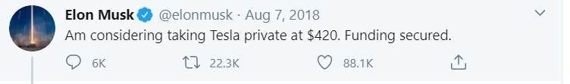

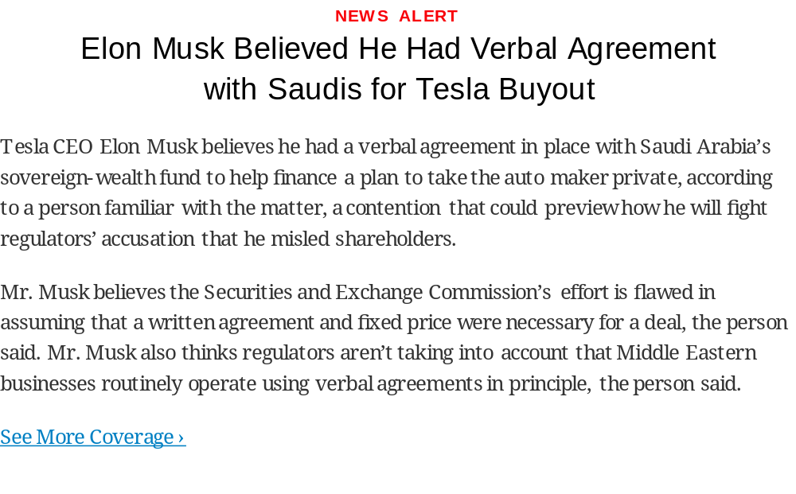

Slide 13
Potential effects of preliminary statements
No legal effect
Contract:
  Enforceable agreement subject to formalization (Tribune I)
  Enforceable agreement to negotiate in good faith (Tribune II)
Promissory estoppel
Misrepresentation (tort)
Promissory fraud (tort)
Background rules:
No general duty to negotiate in good faith
Recovery in restitution may be available for benefits conferred

Slide 14
Tribune I agreements (190)
“…occurs when the parties have reached complete agreement (including the agreement to be bound) on all the issues perceived to require negotiation. Such an agreement is preliminary only in form—only in the sense that the parties desire a more elaborate formalization of the agreement. The second stage is not necessary; it is merely considered desirable….[The agreement] binds both sides to their ultimate contractual objective in recognition that that contract has been reached, despite the anticipation of further formalities.”
Teachers Ins. and Annuity Ass'n of America v. Tribune Co. 670 F. Supp. 491 (S.D.N.Y. 1987)

Slide 15
Tribune I agreements
  Factors suggesting a preliminary agreement is not binding:
  Disclaimer of intention to be bound
  Indefiniteness
  Complex transaction
  Factors suggesting a preliminary agreement is binding:
  Formality
  Part performance
  Reliance

Slide 16
Questions for all cases
What promise is the claimant seeking to enforce?
Is it sufficiently definite to enforce in contract?
Are mutual assent and consideration present?
Has the promise been breached?
What is the remedy?
Is recovery available in promissory estoppel?
How could the parties have avoided this dispute?
How should they behave going forward?
Would the result be different under French law?

Slide 17
French Civil Code (2016)
Art. 1112. –The commencement, continuation and breaking-off of precontractual negotiations are free from control. They must mandatorily satisfy the requirements of good faith.
In case of fault committed during the negotiations, the reparation of the resulting loss is not calculated so as to compensate the loss of benefits which were expected from the contract that was not concluded.

Slide 18
Channel Home Centers (345)
“The Channel Home Centers Division of Grace Retail Corporation has approved the leasing of a store at the above described location subject to the terms and conditions of this letter. The purpose of this letter is to express the understanding under which an Agreement of Lease, prepared by Tenant, but in a mutually satisfactory form, is to be executed….”
….
“To induce the Tenant to proceed with the leasing of this Store, you will withdraw the Store from the rental market, and only negotiate the above described leasing transaction to completion.”

Slide 19
Cyberchron v. Calldata Systems Development (340)
“…in mid-July 1990, Grumman's Wilhelm directed Cyberchron's Paul “to proceed ‘as if the new set of weights was approved ... and we would work out the definitization of the purchase order later.’ ” Id. at 102 (quoting Paul testimony, alteration in district court opinion). Later, when Paul asked Wilhelm to put this reassurance in writing, Wilhelm refused. Id. at 114. Paul then stated that: “ ‘If I have your assurance that we will resolve the issues in the very near future ...-we will proceed.’ ” Id. (quoting Paul testimony, alteration added). Wilhelm responded: “ ‘[Y]ou should proceed.’ ” Id. (quoting Paul testimony).”

Slide 20
Dixon v. Wells Fargo (333)
“Wells Fargo made a specific promise to consider the Dixons’ eligibility for a loan modification if they defaulted on their payments and submitted certain financial information.”

Slide 21
Recap
Is there an enforceable promise?
  Common law: offer and acceptance, consideration, definiteness
  UCC §§ 2-204 – 2-207 (sale of goods only)
  Promissory estoppel
  RLCC § 2 (consumer contracts)
  Statute of Frauds (selected transactions)
Has it been performed?
Applications:
  Battle of the forms
  Terms that follow
  Preliminary negotiations

